Slide 1
Research on path planning algorithm based on deep reinforcement learning
VIN Introduction
柴士佳_Shijia CHAI
Notes:
My research topic is about

Slide 2

Notes:
The first part is background.

Slide 3
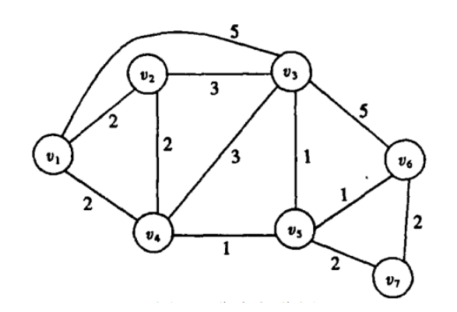
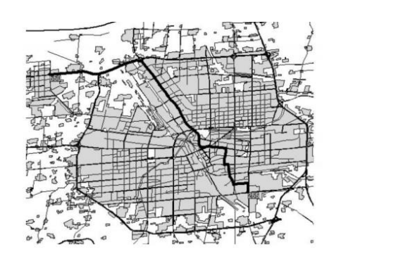
Path planning is a primary task of autonomous control for agents
And we have some traditional methods.
Dijkstra algorithm A* algorithm
Notes:
Path planning is a primary task of autonomous control for agents. And we have some traditional methods like Dijkstra algorithm and A* algorithm.
.

Slide 4
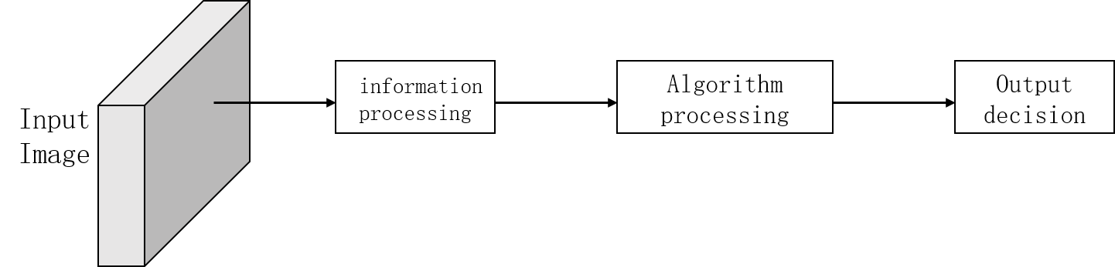
But those methods have some problems.
Not an end-to-end model
No learning ability, no generalization ability
No intelligent understanding of the problem
^{Complex and time consuming}
Notes:
The traditional path planning algorithm has some problems.
Because the separation of graph recognition and path planning, it is not an end-to-end model, the performance of the algorithm has bottlenecks
.

Slide 5
Therefore, the intelligent algorithm based on deep reinforcement learning has been performed.
Input Image
Neural Network
Output decision
An end-to-end training and prediction model
The model has the ability of learning and generalization
Intelligent understanding of the problem
Notes:
An end-to-end training and prediction model
The model has the ability of learning and generalization
Once the model training is completed, it can be directly put into use on the input image, and there is no need to calculate from scratch
Intelligent understanding of the problem can be applied to new, complex scene problems

Slide 6
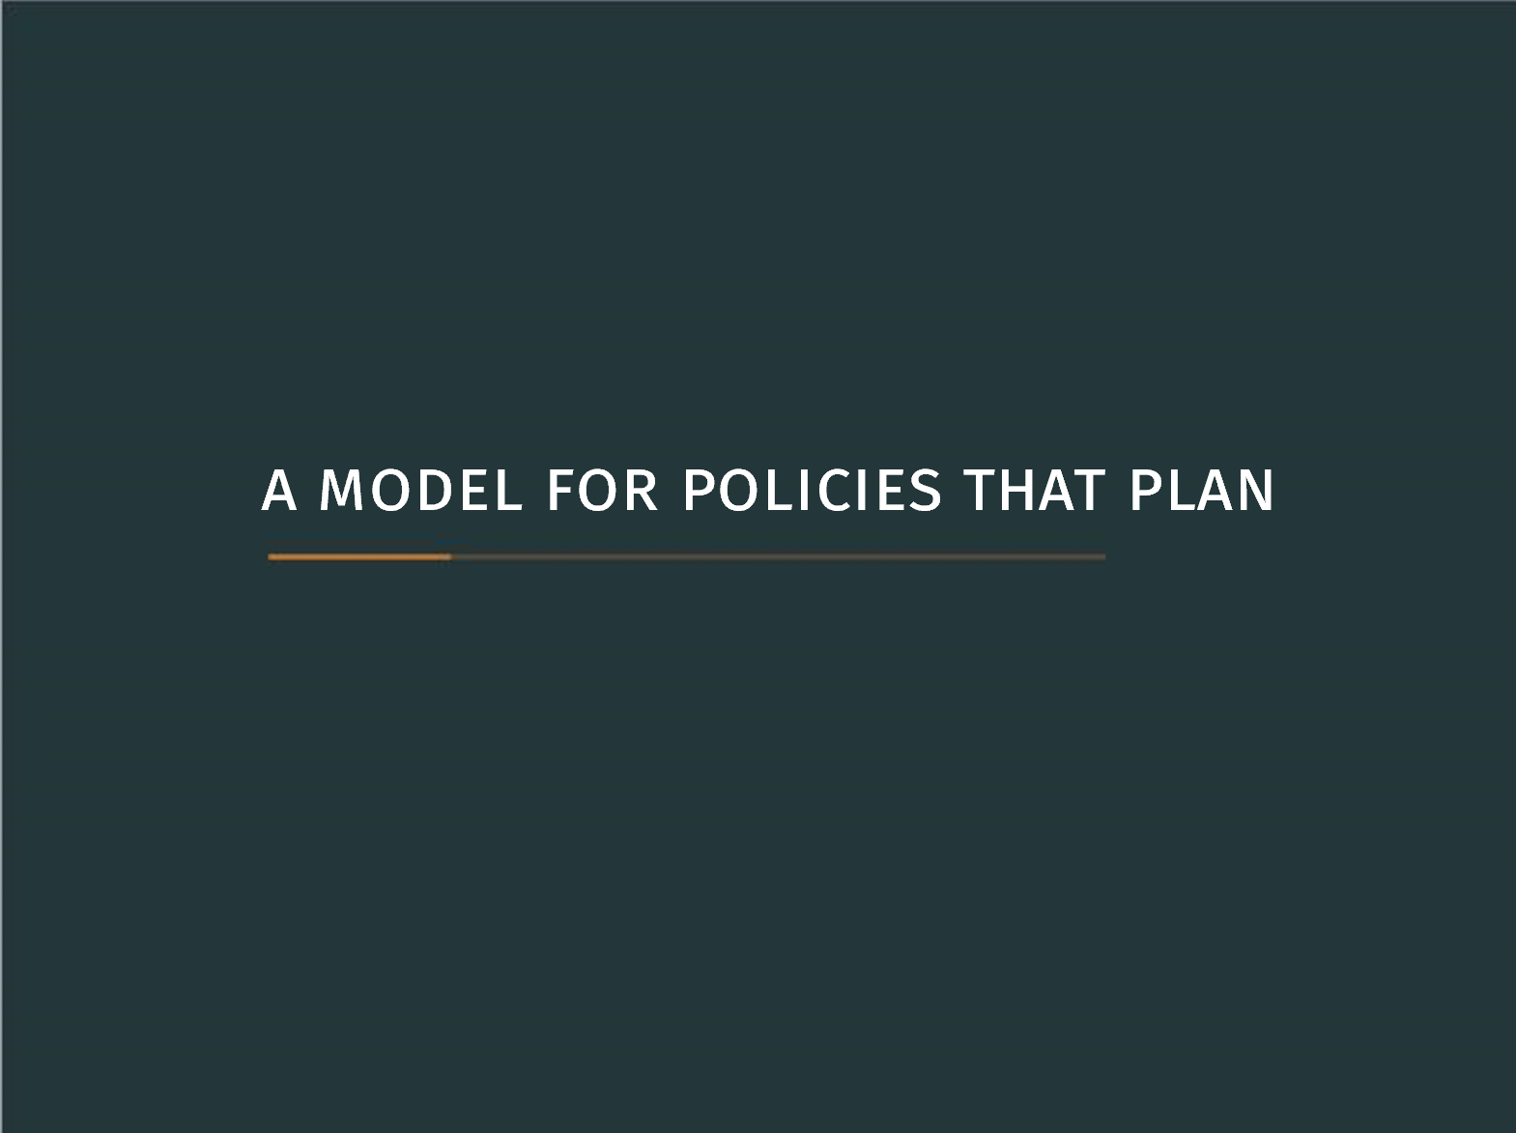

Slide 7
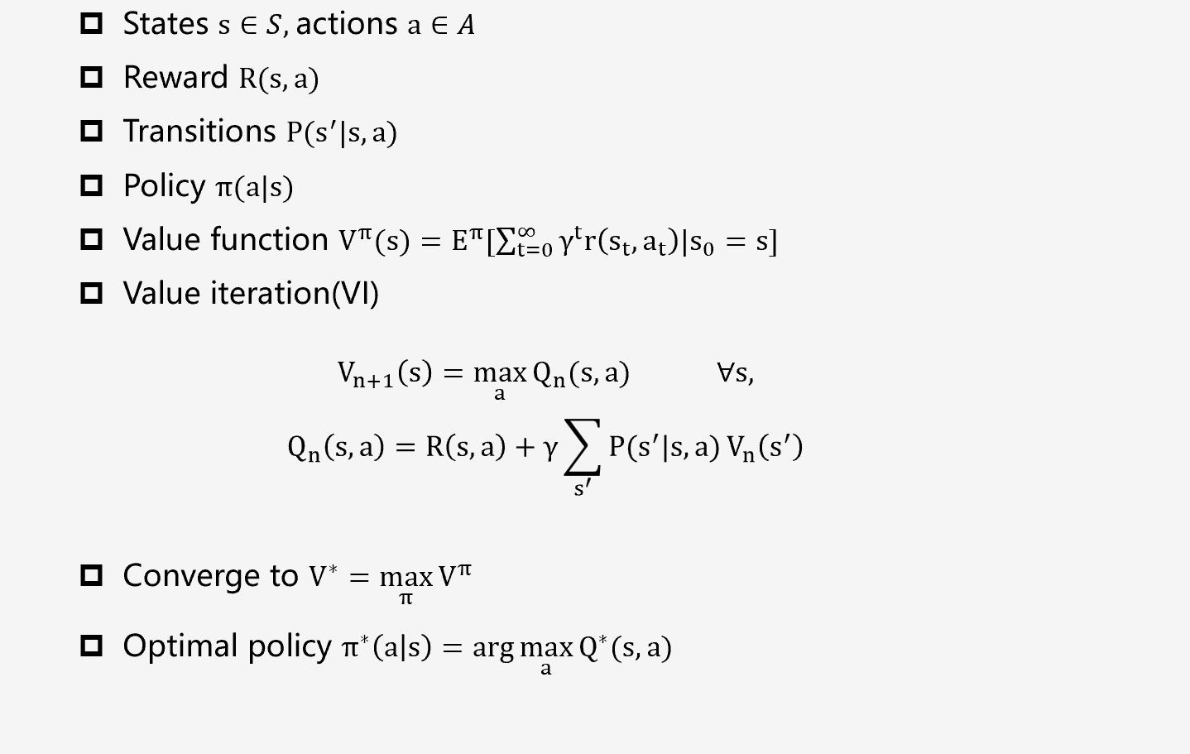
Planning in MDP(Markov Decision Process)
Notes:
Value iteration is based on the Markov decision process (MDP) formulation. The goal is to learn a policy which maximizes the expected return.

Slide 8
Start from a reactive policy;

Slide 9

Add an explicit planning computation
Map the observation to planning MDP $\overline{M}$
Key point: observation will be mapped to a useful but unknown new map and we plan on the new map.

Slide 10
Neural Networks map observation to reward and transitions
Later- learn these
Both of them($\overline{R} and \overline{P})$are trainable.

Slide 11
Value function = sufficient information about plan

Slide 12

Fact is: action prediction can require only subset of $\overline{V^{∗}}$
$$π^{∗}\left(a | s\right)=arg\max_{a}{R\left(s,a\right)+γ\sum_{s^{′}}{P(s^{′}|s,a)V^{∗}(s^{′})}}$$
Use attention models in the networks
Notes:
In fact, action prediction can require only subset of $\overline{V^{∗}}$ ,we choose Q values for current state

Slide 13
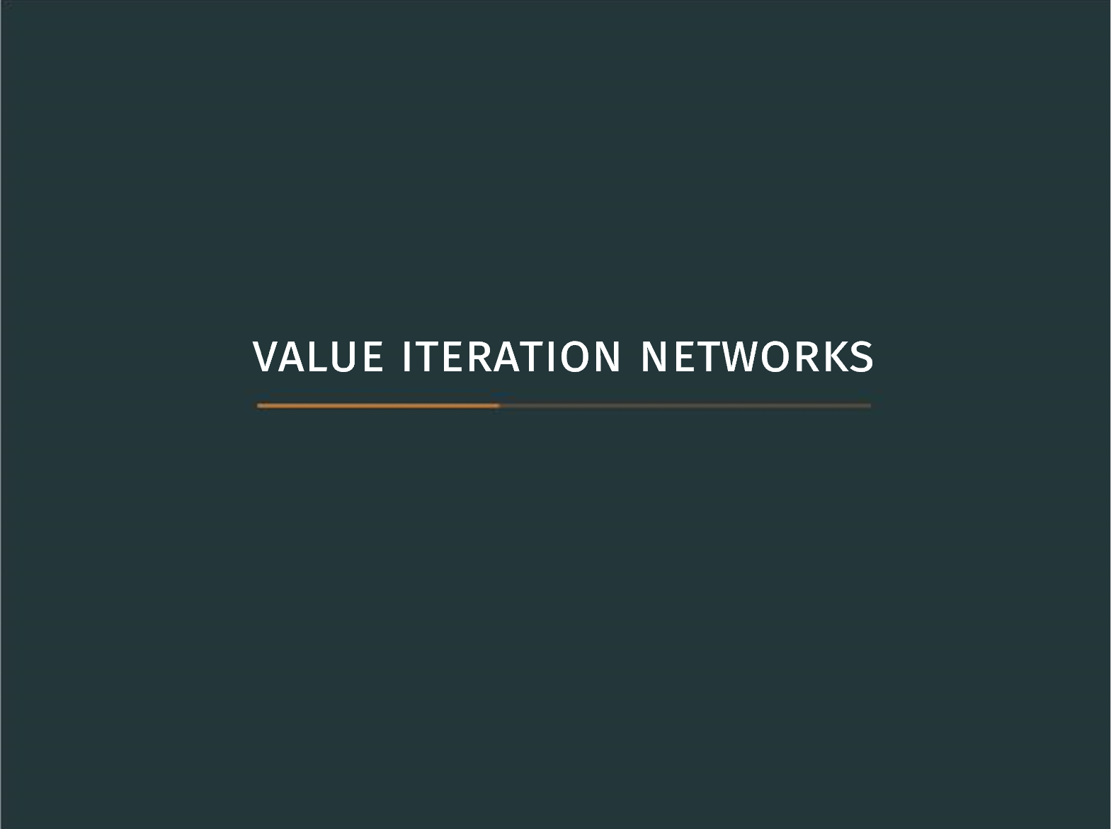

Slide 14
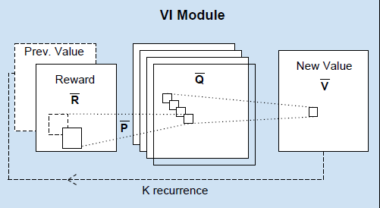

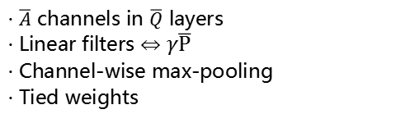

Value Iteration:
Convnet :
K iterations of:
$$Q_{n}\left(s,a\right)=R\left(s,a\right)+γ\sum_{s^{′}}{P(s^{′}|s,a)}V_{n}\left(s^{′}\right)$$
$$V_{n+1}\left(s\right)=\max_{a}{Q_{n}(s,a)} ∀s,$$
· $\overline{A}$ channels in $\overline{Q}$ layers
· Linear filters $⇔$ $γ\overline{P}$
· Channel-wise max-pooling
· Tied weights
·Best for locally connected problems(grids, graphs)
Notes:
What makes that special is that the value iteration of the mathematical formula is corresponding to the convolutional network structure.

Slide 15
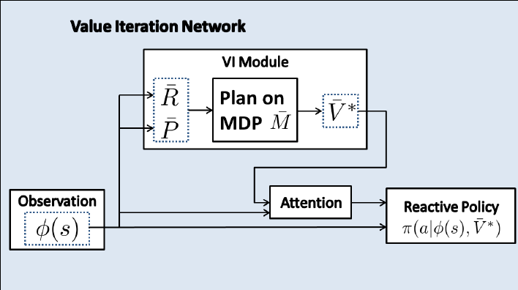
Use VI model for planning:

Slide 16
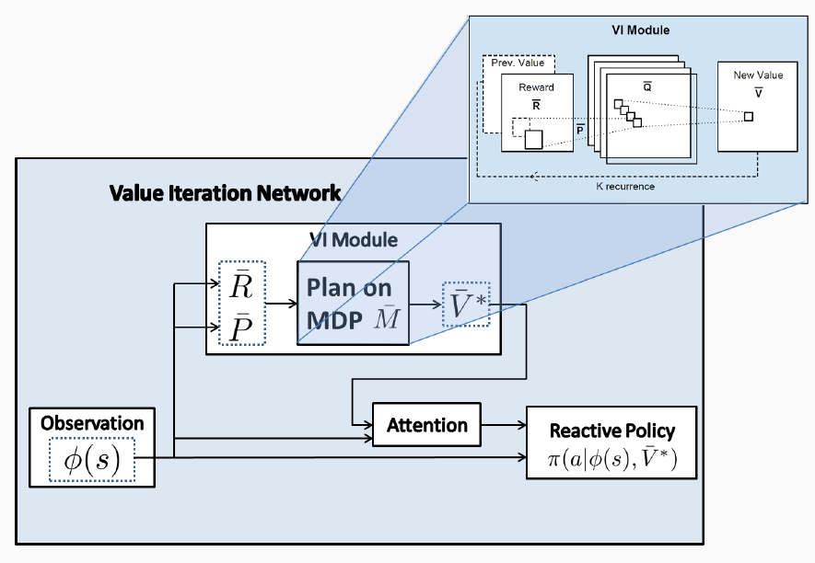
Value iteration Network(VIN)
Notes:
Plan and get reward map on MDP,

Slide 17
Use Neural Network to achieve Value Iteration
The Networks can learn to plan
Train like any other Networks
Backprop – just like a convent
Implementation – Use TensorFlow or Pytorch

Slide 18
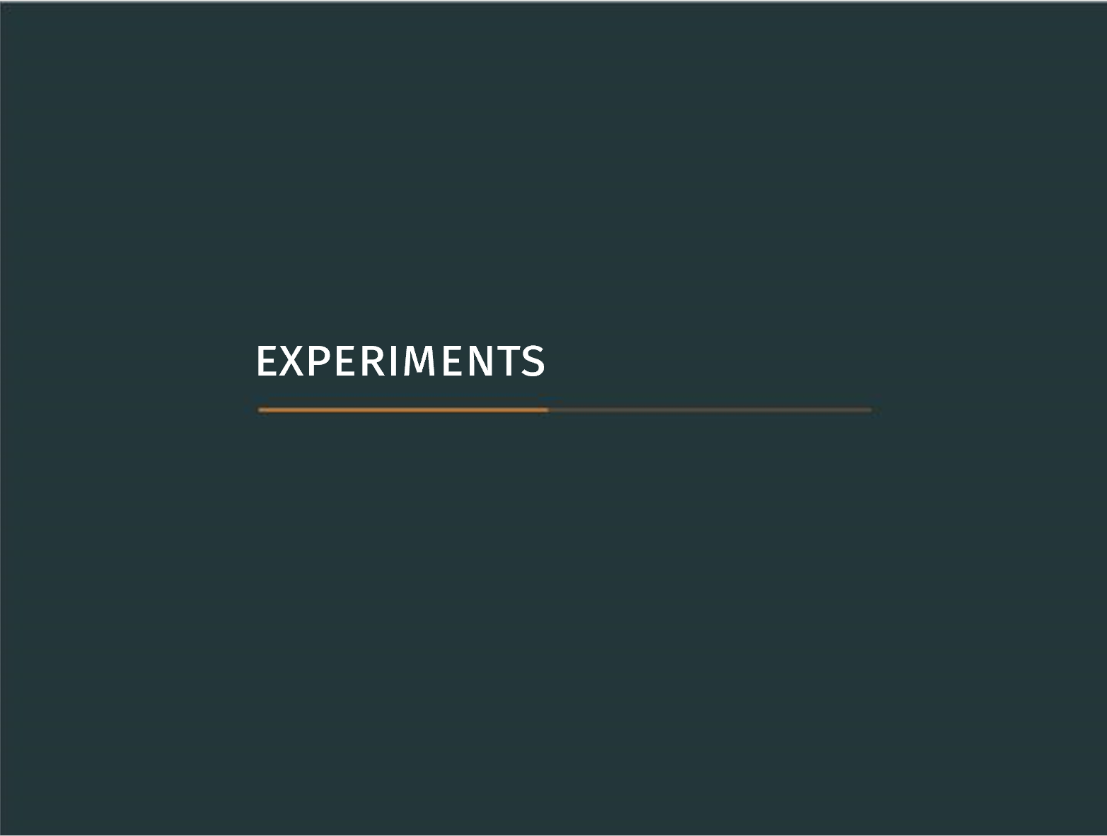

Slide 19
Supervised learning from expert(shortest path)
Observation: image of obstacles + goal, current state
Compare VINs with reactive policies

Slide 20
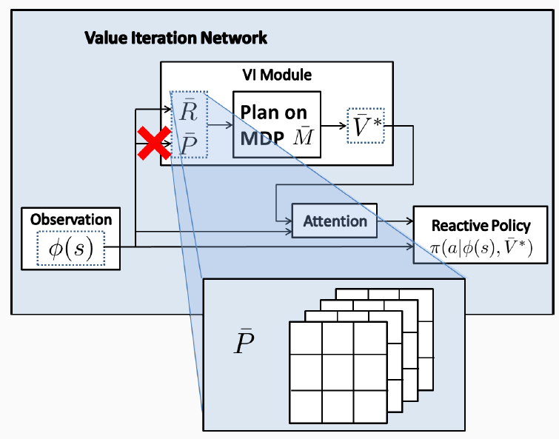
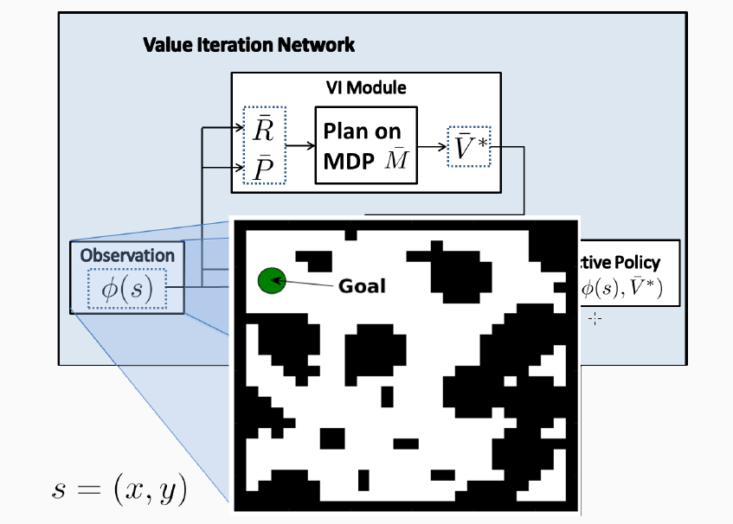
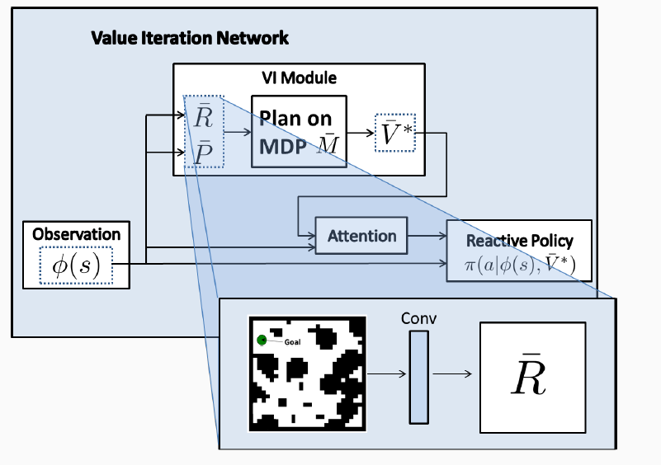
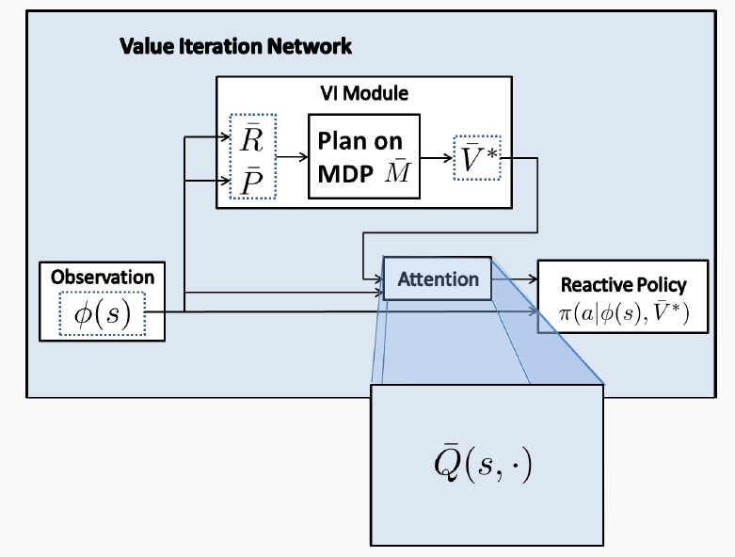
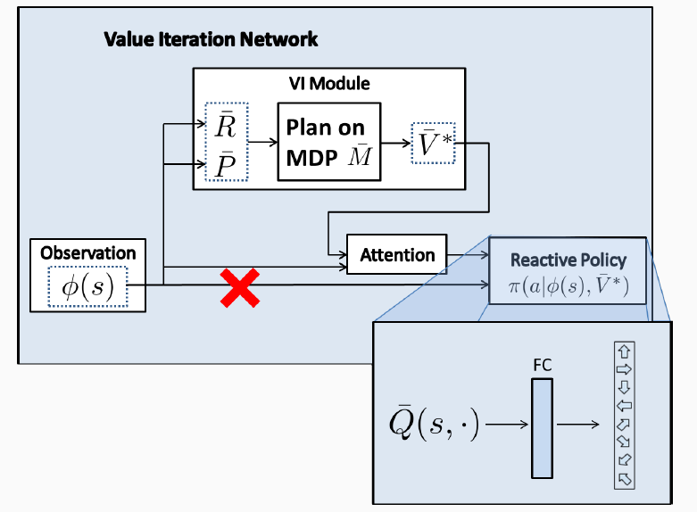
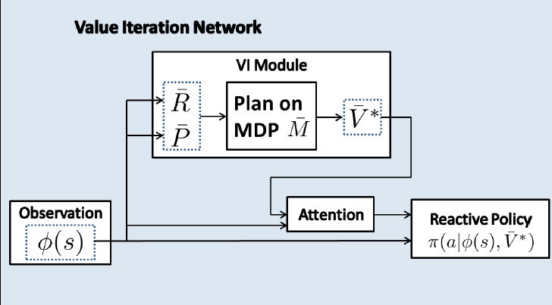
· VI State space: grid-world
· Attentions: choose Q values for current state
· VI Reward map: Convent
· VI Transitions: 3×3 kernels
· Reactive Policy: FC, softmax

Slide 21
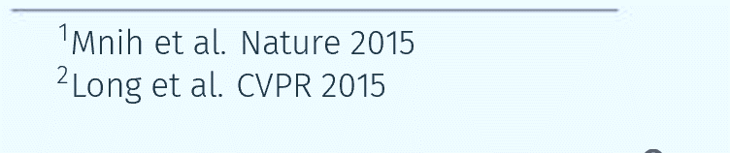
Compare with:
CNN inspired by DQN architecture¹
· 5 layers
· Current state as additional input channel
Fully convolutional net (FCN) ²
· Similar to our attention mechanism
∙ 3 layers
∙ Pixel-wise semantic segmentation (labels=actions)
Training:
5000 random maps, 7 trajectories in each
Supervised learning from shortest path

Slide 22
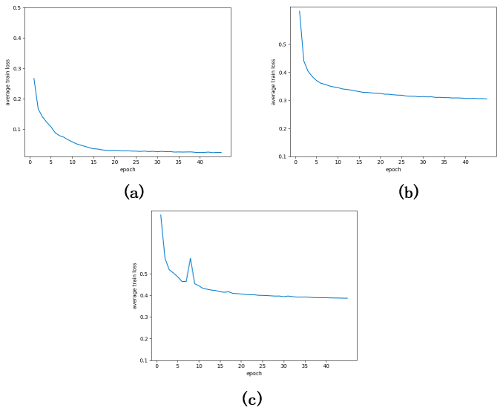
Results:
Average training loss:
Success rate on test set:
Need further improvement!
· Success rate – reach target without hitting obstacles

Slide 23
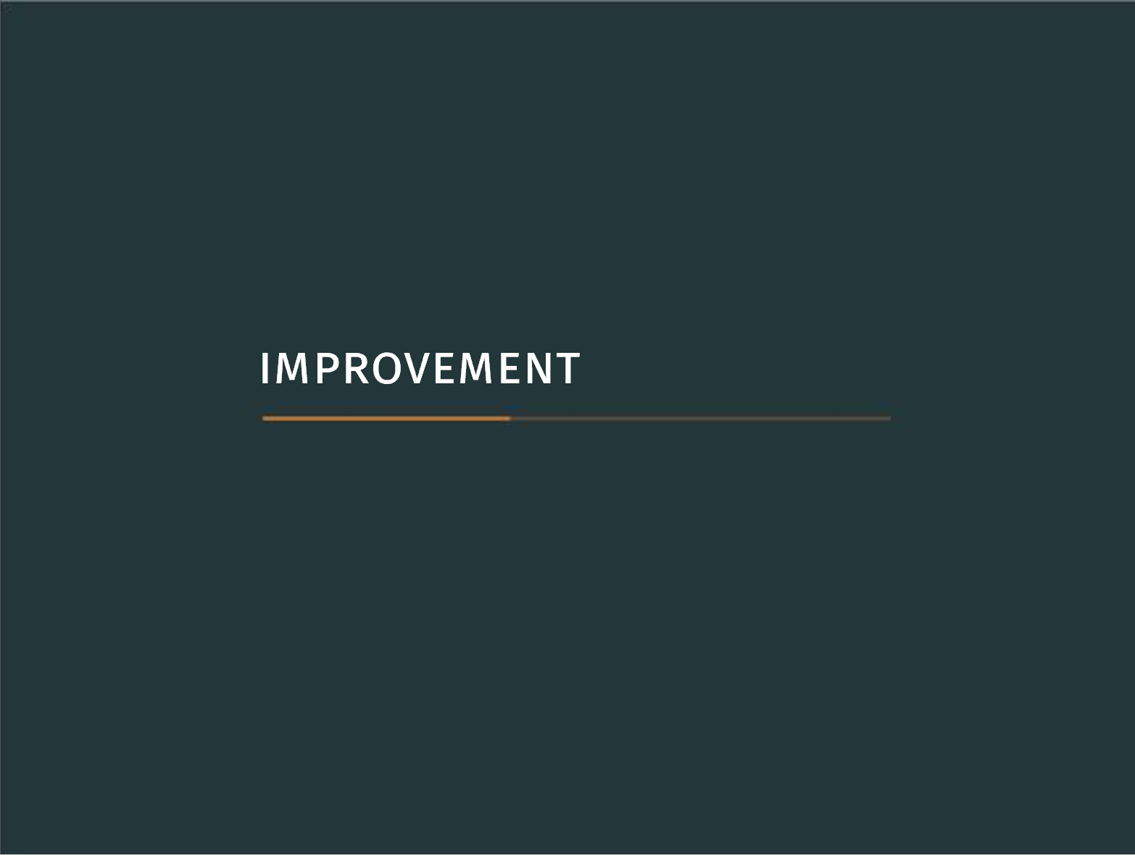

Slide 24
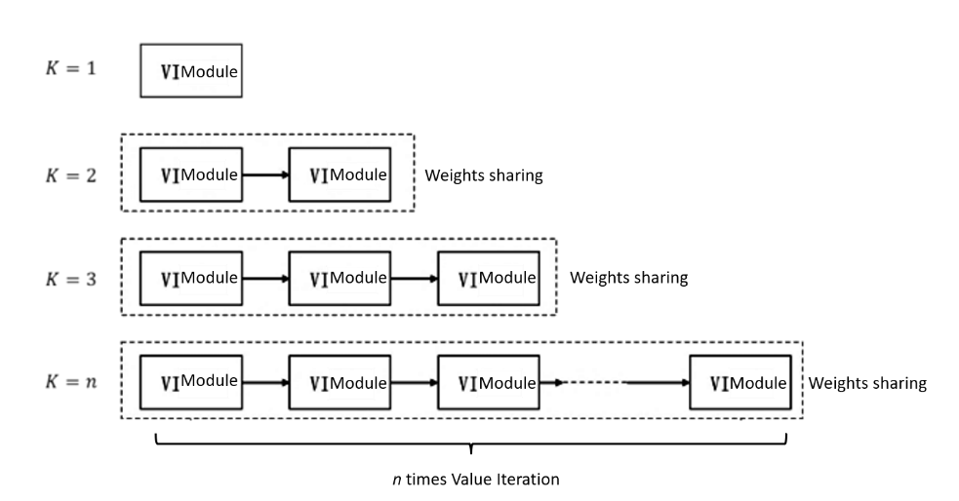
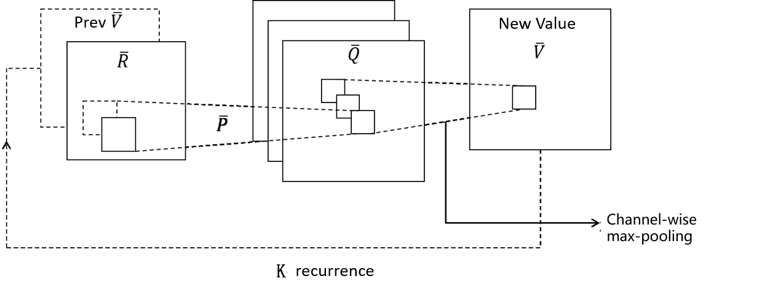
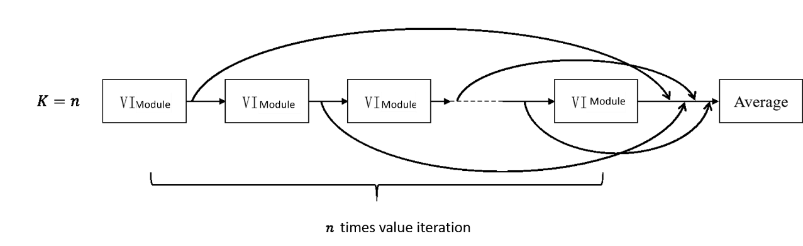
Use deeper value iteration network:
Value iteration module
Skip-connections
▪ Each value iteration uses different parameters
▪ Improve data flow with jump connections
▪ Greatly enhance the depth of the network
Notes:
In VINs, we tied the weights in all VI models(Weights Sharing). If we untie the weights in VI models, which means that for each VI module, we use different weights. And use skip-coonections between vi modules.

Slide 25
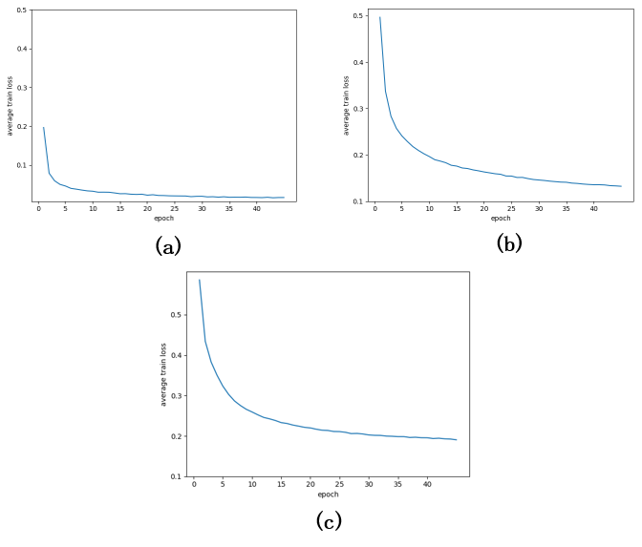
Use deeper value iteration network:
Average training loss:
Prediction accuracy
The average training loss of the network is obviously reduced, it performs well on the training set
The accuracy is over 92% on the big map of the test set, which is significantly improved
Notes:
The average training loss of the network is obviously reduced, and it performs well on the training set
The accuracy of the network is over 92% on the big map of the test set, which is significantly improved

Slide 26
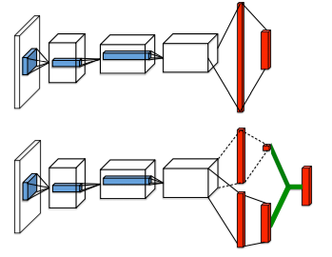
Use Dueling Architecture(ICML2016)
-We notice that the Q function can be written into two parts:
$$Q_{π}\left(s,a\right)=V_{π}\left(s\right)+A_{π}(s,a)$$
-We only need to change the last layers(FC layers, softmax)
▪Competition structure
▪Two-channel output
Notes:
We notice that the Q function can be written into two parts:We only need to change the last layers(FC layers, softmax)

Slide 27
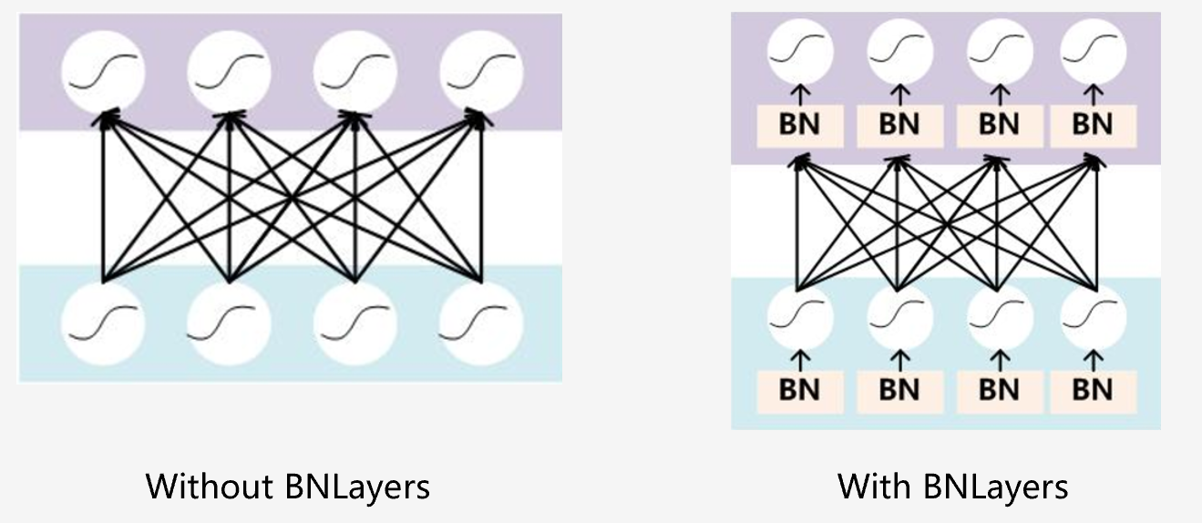

Use Batch Normalization(BN_Layers)
-We have
$$y=\frac{x−E[x]}{\sqrt{Var\left[x\right]+ε}}∗γ+β$$
-Converge faster
-Use a larger learning rate
-Reduce loss function
-Avoid gradient explosion
Notes:
Converge faster
-Use a larger learning rate
-Reduce loss function and Avoid gradient explosion

Slide 28
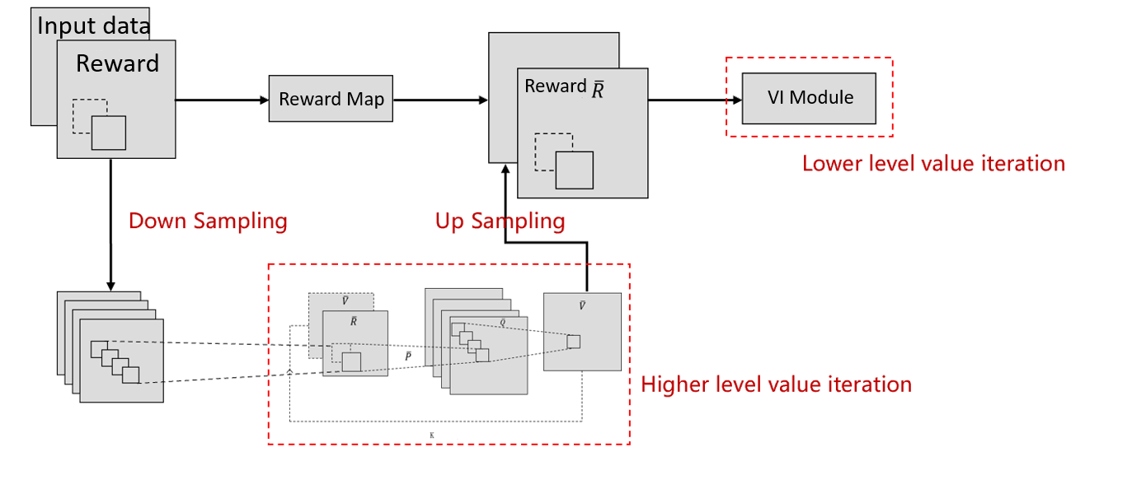
Hierarchical Structure VIN:
To convey reward information faster in VI, and reduce the effective K, we use multiple levels of resolution.
Notes:
To convey reward information faster in VI, and reduce the effective K, we use multiple levels of VIN. A copy of the input is fed into a convolution layer and then down-sampled. Then it is fed into a VI module and then up-sampled, and added as an additional channel in the reward layer.

Slide 29
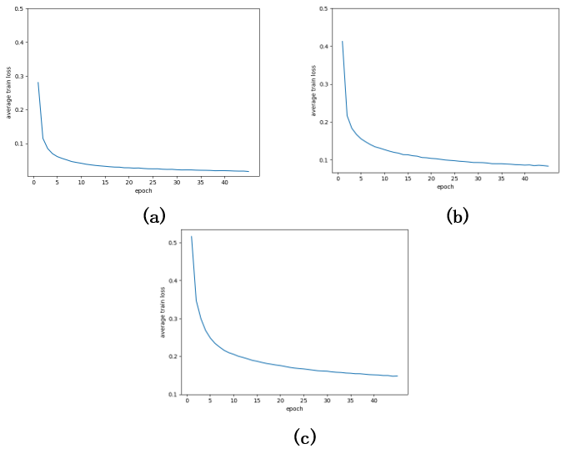
Use all the tricks
Average training loss:
Prediction accuracy
The convergence speed of the network is accelerated and the average training loss is further reduced
The model has the best performance with 93.7989% accuracy on the test set.
Notes:
The convergence speed of the network is accelerated and the average training loss is further reduced
The model has the best performance with 93.7989% accuracy on the big maps of test sets.

Slide 30
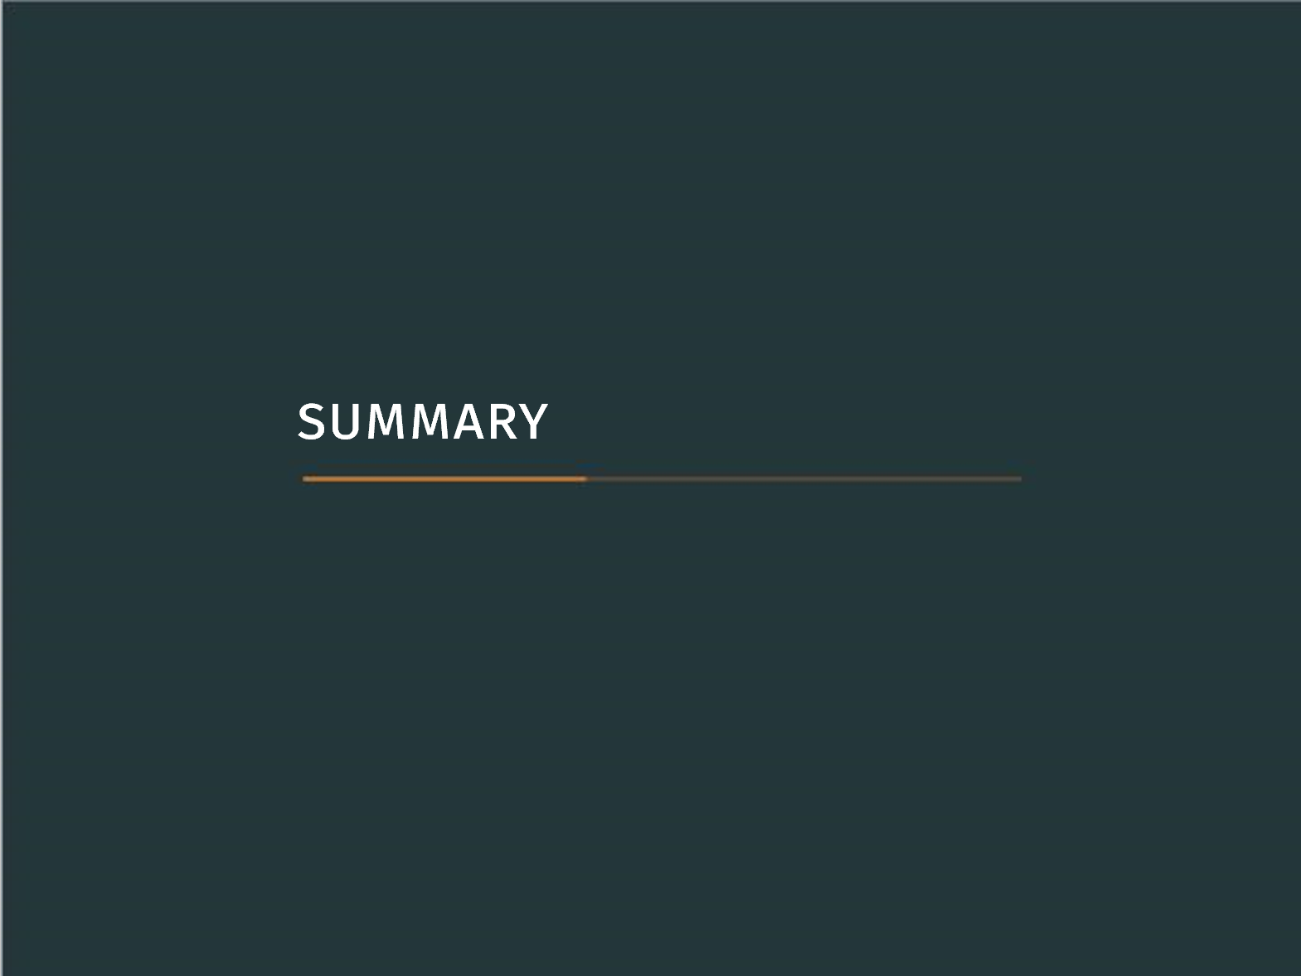
Notes:
你好！！！

Slide 31
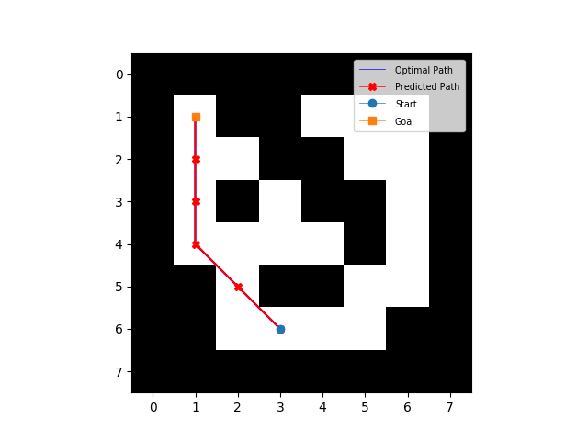
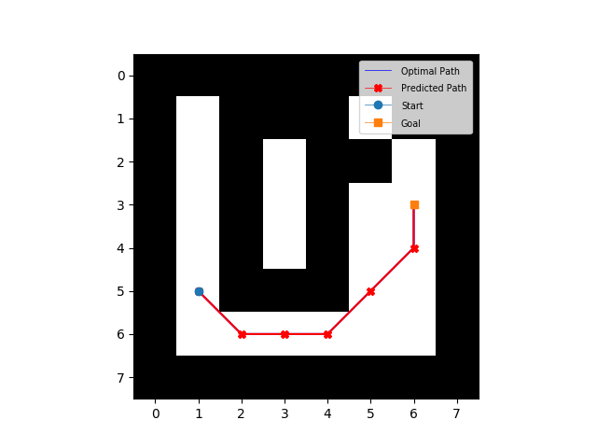
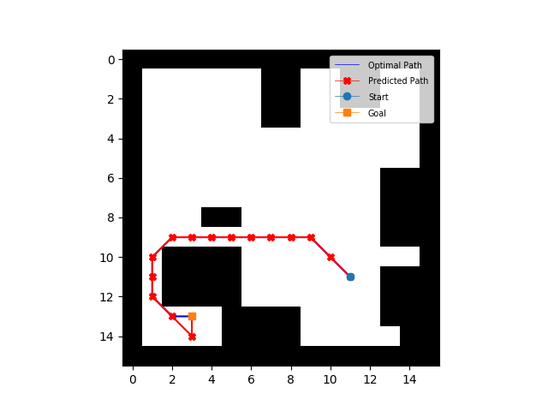
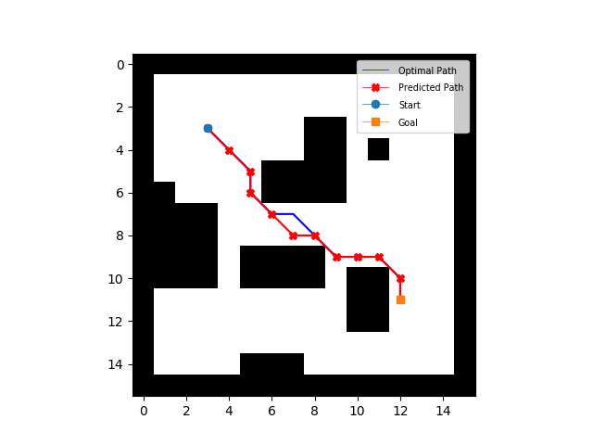
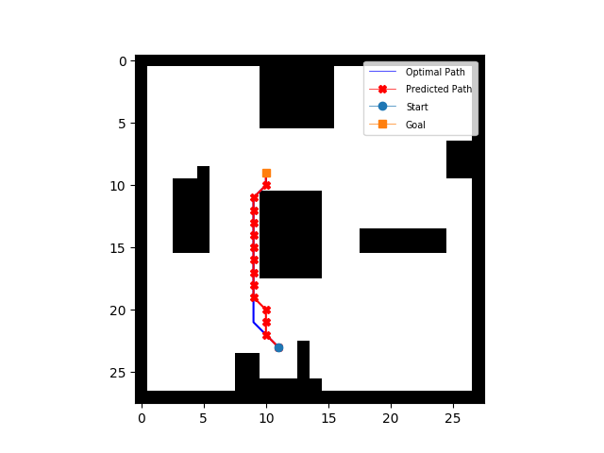
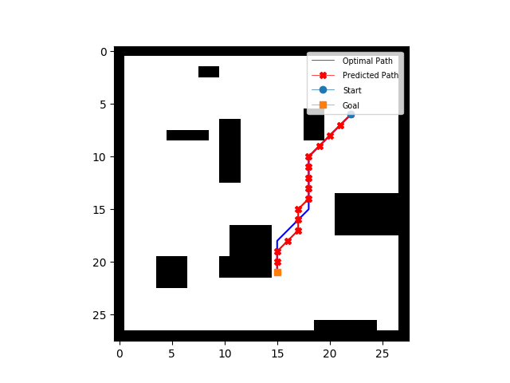
Path planning results
8×8:
16×16:
28×28:

Slide 32
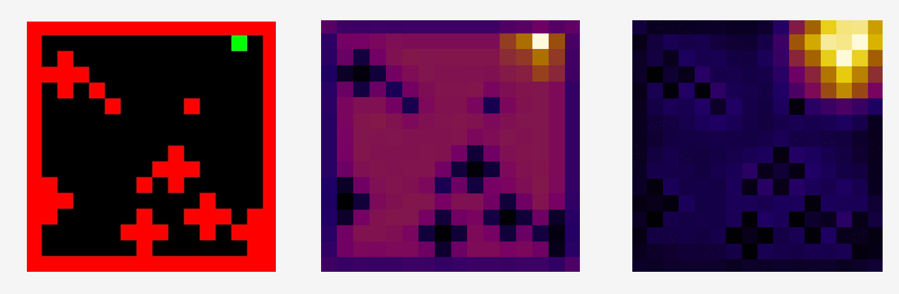
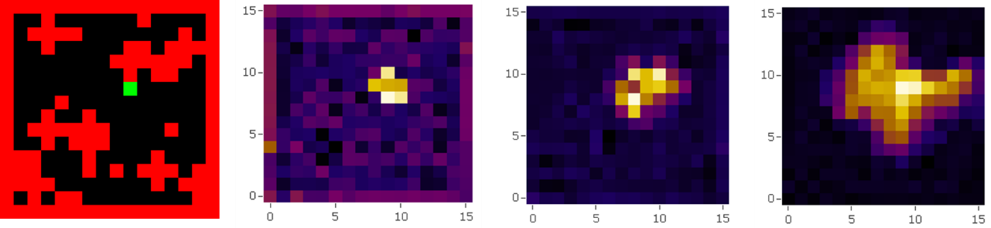
Value iteration process
With VI Iteration!
Notes:
Here is Value iteration process. As you can see,the place around the target position gradually becomes bright, indicating that the corresponding position value is high and the agent should be there as close as possible.
The area of the obstacle is turning black, indicating that the corresponding position value is low and the agent should avoid there as far as possible
through value iteration, the network can seek advantages and avoid disadvantages, and has the planning ability.

Slide 33
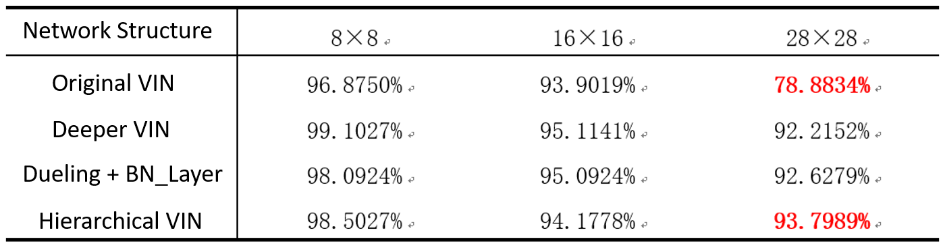
The performance of the models is summarized as follows
Finally, the accuracy of the improved network is higher than 93% on different size maps
The performance of the network on the big map has improved significantly, from less than 79% to more than 93%
It shows that a series of improvements are effective and the network generalization ability is improved

Slide 34
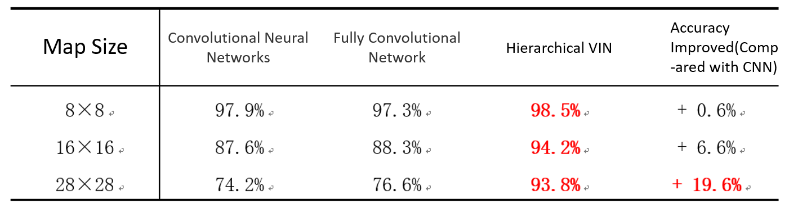
Compared with CNN and FCN
Our improved networks get best performance on any size of map
The accuracy of the network is higher than 93% on different maps
Especially on the large map, the accuracy is significantly improved, and it is increased by nearly 20%
Notes:
Our improved networks perform best on any size of map
The accuracy of the network is higher than 93% on different maps
Especially on the large map, the accuracy rate is significantly improved, and the accuracy rate is increased by nearly 20%
The network long-term planning ability and generalization ability have been significantly improved
The network has the structure of planning and has the planning ability

Slide 35
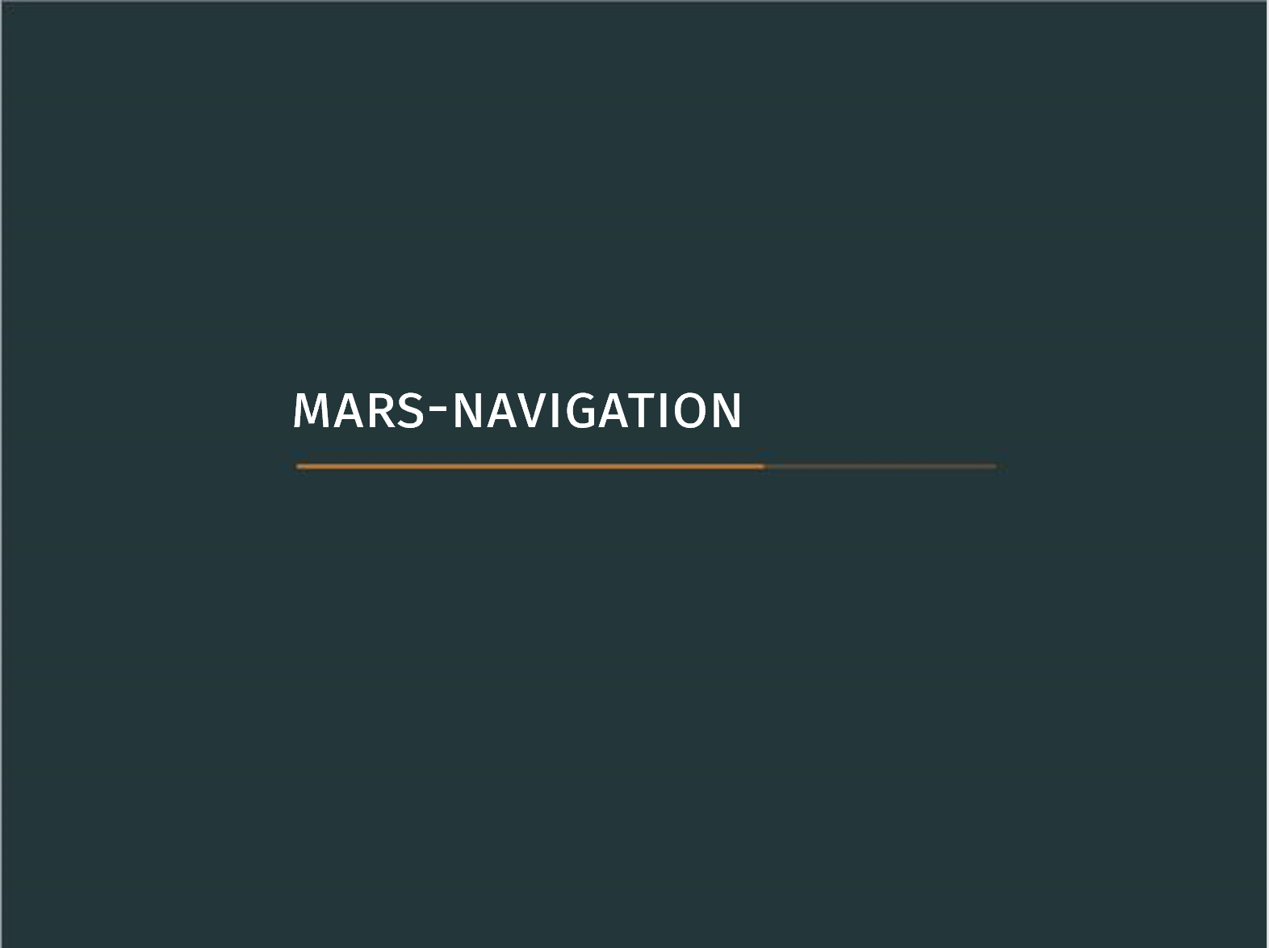
Notes:
So, what if I input a natural image to the VIN? Does the network work or not?

Slide 36
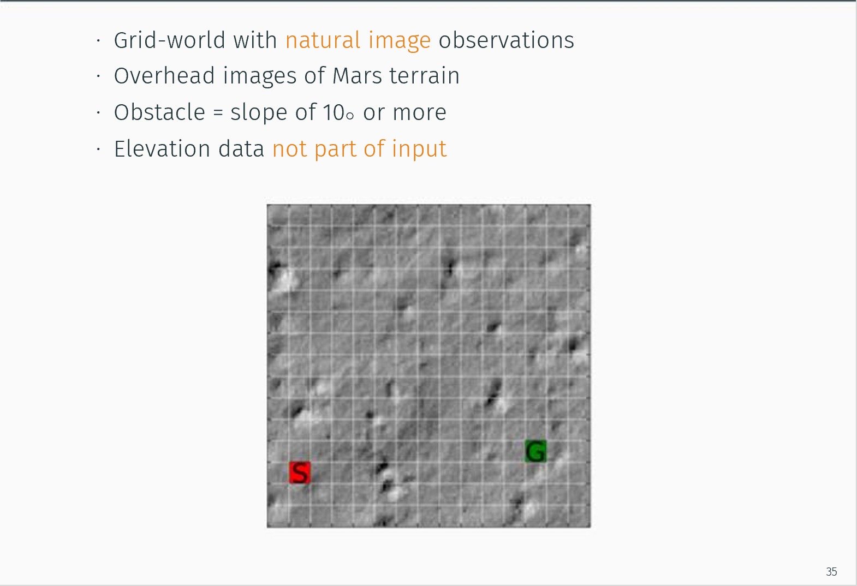
Notes:
In this experiment we show that VINs can learn to plan from natural image input

Slide 37
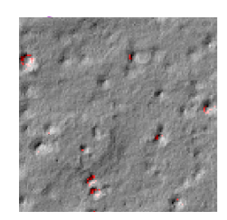
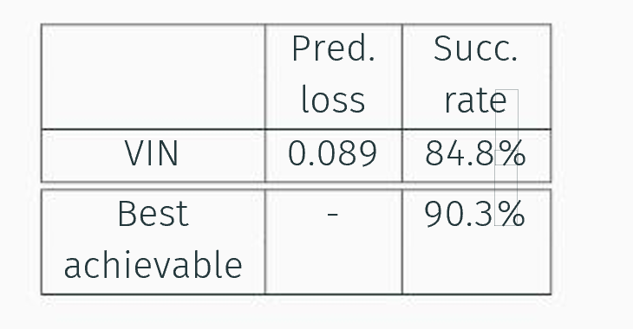
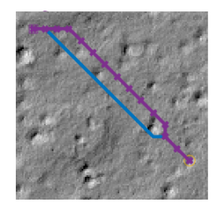
Results:
Notes:
After training, VIN achieved a success rate of 84.8%

Slide 38
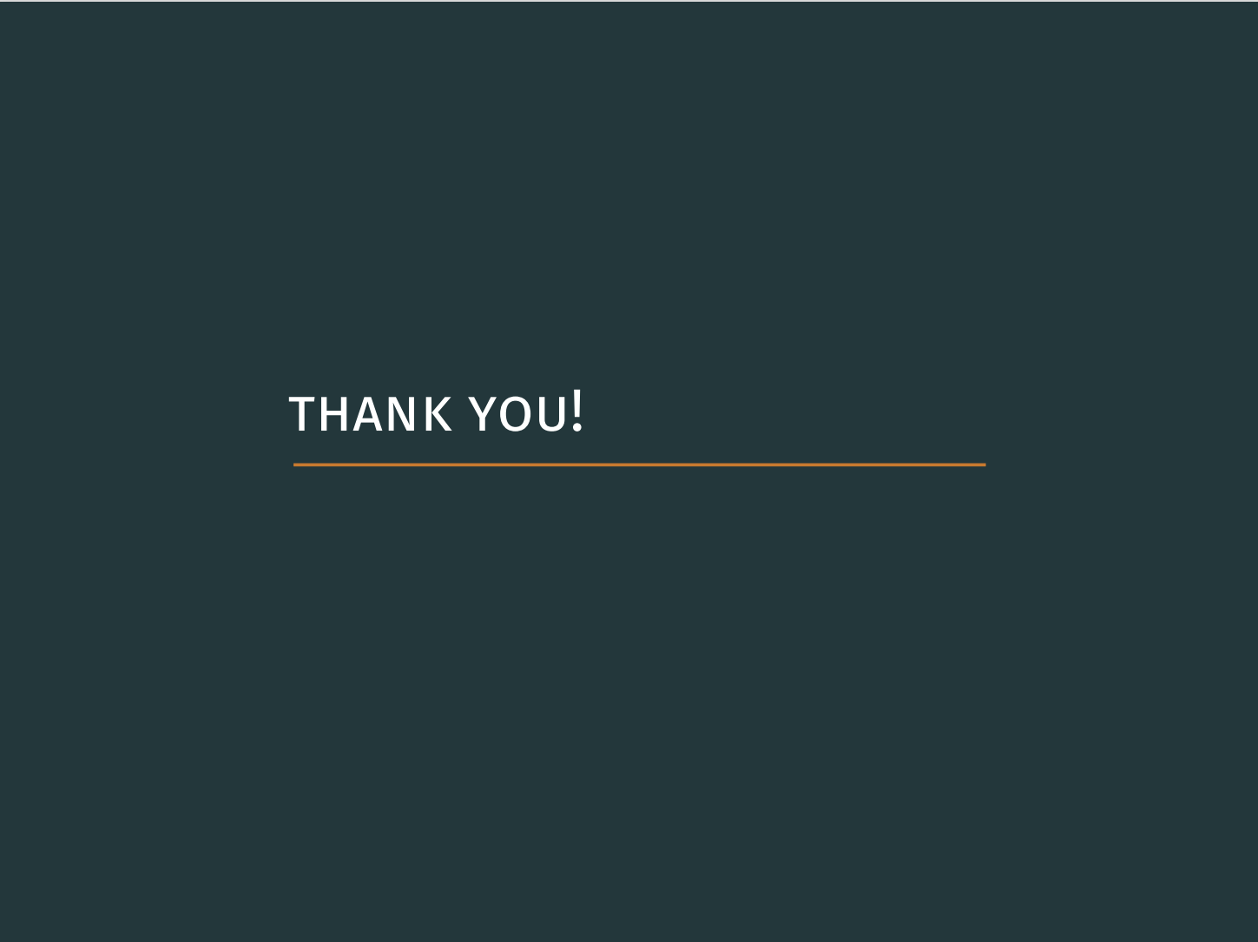

Slide 39
章永龙. Dijkstra最短路径算法优化[J]. 南昌工程学院学报, 2006, 25(3):30-33.
史辉, 曹闻, 朱述龙, et al. A*算法的改进及其在路径规划中的应用[J]. 测绘与空间地理信息, 2009, 32(6):208-211.
Volodymyr Mnih, et al. Human-level control through deep reinforcement learning[J]. Nature, 2015, 518: 529-533
Aviv Tamar, Yi Wu, Garrett Thomas, et al. Value iteration networks[C]. Advances in Neural Information Processing Systems, 2016: 2154-2162
Ren S., He K., Girshick R., et al. Faster r-cnn: Towards real-time object detection with region proposal networks[C]. Advances in neural information processing systems, 2015: 91-99
Ziyu Wang, et al. Dueling Network Architectures for Deep Reinforcement Learning[J]. arXiv preprint arXiv:1511.06581, 2016
Richard S.Sutton, et al. Reinforcement Learning: An Introduction 2nd ed[M]. London: The MIT Press, 2017: 59-69
Cormen, et al. Introduction to Algorithms 2nd ed[M]. The MIT Press & McGraw-Hill, 2001: 344
Tieleman, Tijmen, and Geoffrey Hinton. Lecture 6.5-rmsprop: Divide the gradient by a running average of its recent magnitude. COURSERA: Neural networks for machine learning 4.2, 2012: 26-31
Gao Huang, Zhuang Liu, et al. Densely Connected Convolutional Networks[C]. Computer Vision and Pattern Recognition, 2017: 4700-4708

